Slide 1
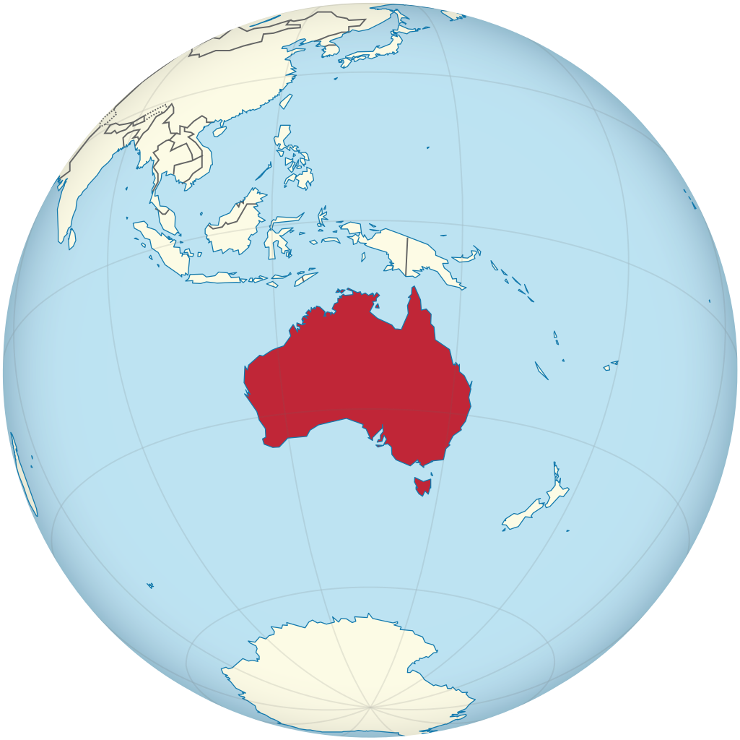
Section 2
PPT Revision
Section 1 Australia

Slide 2
Australia
is
a
big
country
.

Slide 3
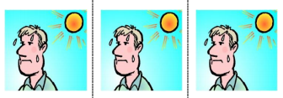

+
very
very
dry
It
is
,
,
very
hot
and
.

Slide 4
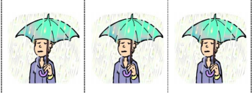
sometimes
.
But
it
rains
and
rains
and
rains

Slide 5
Picture acknowledgements:
* Australia on the globe | This Photo by Unknown Author is licensed under CC BY-SA
Project team
Vicki Hambling, Lorraine Hatcher-Friel, Sue Paull, Madelena Scott, Mary Wallace, Visual Domain
Acknowledgements
The Project Team would like to thank the AMEP Service Providers and practitioners who participated in the trial and gave valuable feedback.

Slide 6


This Floods Teaching Material is licensed under a Creative Commons Attribution-NoDerivs 3.0 Australia licence (More information is available here). You are free to use, copy and distribute to anyone in its original form as long as you attribute Department of Home Affairs as the author and you license any derivative work you make available under the same licence.
© Commonwealth of Australia 2021
With the exception of the Commonwealth Coat of Arms, the department’s logo, any material protected by a trade mark and where otherwise noted all material presented in this document is provided under a Creative Commons Attribution 4.0 International (https://creativecommons.org/licenses/by/4.0/) licence.
The details of the relevant licence conditions are available on the Creative Commons website (accessible using the links provided) as is the full legal code for the CC BY 4.0 licence (https://creativecommons.org/licenses/by/4.0/legalcode).
Use of all or part of this document must include the following attribution:-
© Commonwealth of Australia 2021
As far as practicable, material for which the copyright is owned by a third party will be clearly labelled. The department has made all reasonable efforts to ensure that this material has been reproduced in this document with the full consent of the copyright owners.
Copyright requests and enquiries concerning usage not addressed by the CC BY 4.0 licence should be addressed to:
comms@homeaffairs.gov.au at the Department of Home Affairs.
The terms of use for the Commonwealth Coat of Arms are available from the It's an Honour website.
Where a copyright owner, other than the Commonwealth, is identified with respect to this
material, please contact that third party copyright owner directly to seek permission.

