Slide 1

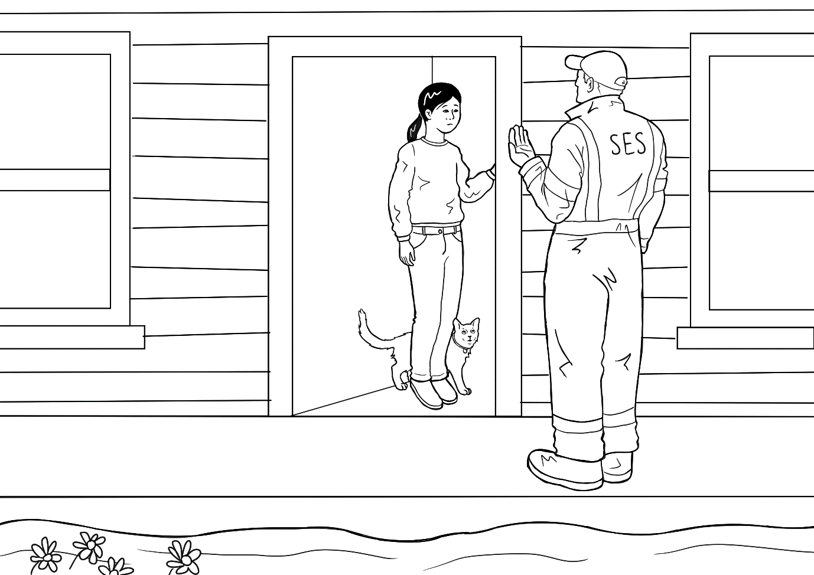
SECTION 5
PPT
Leave Now –
short version

Slide 2
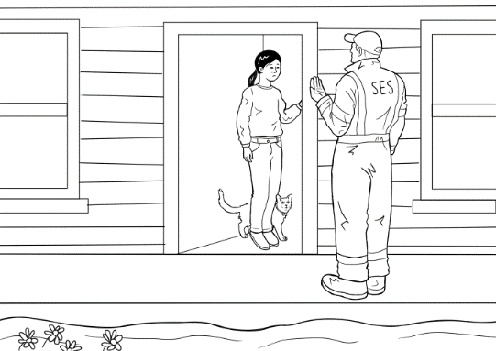
The
SES
man
says
“
”
.
,
Leave
now

Slide 3
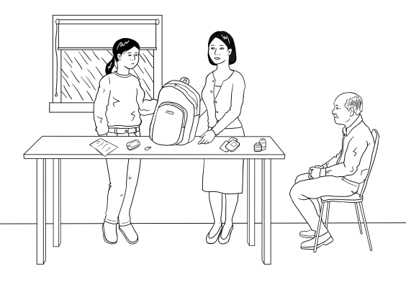
“
Pack
the
bag
”
.

Slide 4
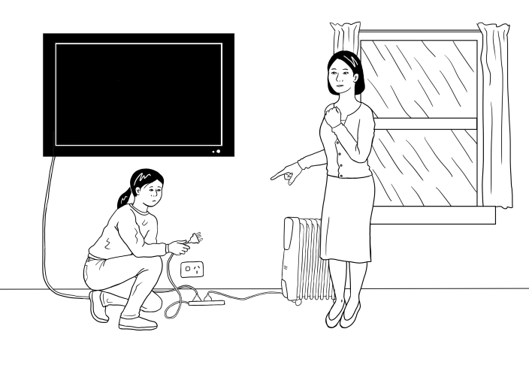
“
”
Unplug
the
.
TV

Slide 5
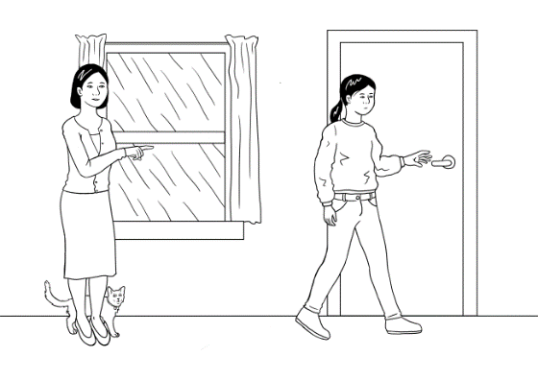
“
Go
and
get
the
laptop
”
.

Slide 6
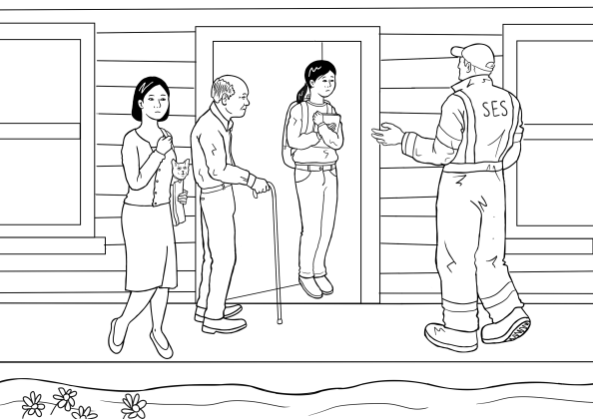
“
Come
quickly
”
.
Hurry
.

Slide 7
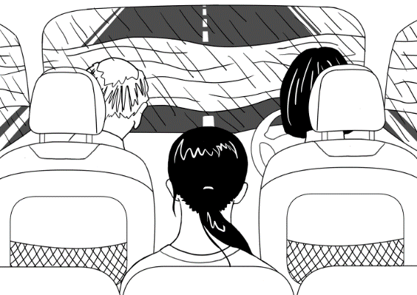
“
?
”
Is
it
safe
to
drive

Slide 8
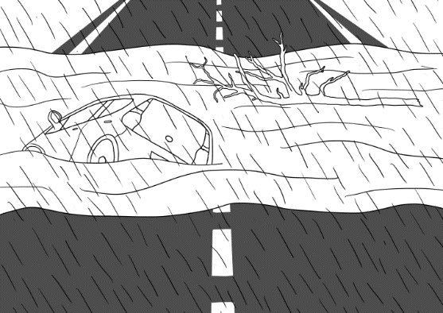
“
Look
at
the
car
the
tree
”
Oh
no
and
.
.

Slide 9
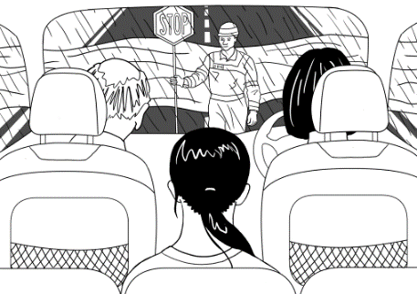
“
”
Stop
mum
,
!

Slide 10
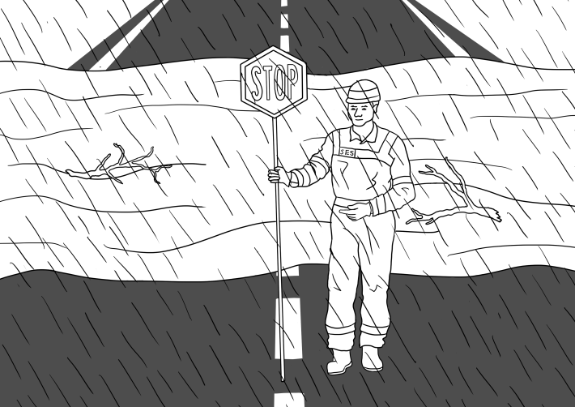
“
”
Stop
Drive
sports
centre
.
to
the
.

Slide 11
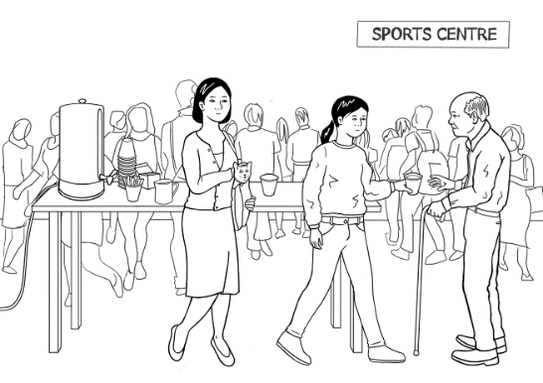
.
Mai
and
her
family
are
safe

Slide 12
Illustrations by Madelena Scott
Project team
Vicki Hambling, Lorraine Hatcher-Friel, Sue Paull, Madelena Scott, Mary Wallace, Visual Domain
Acknowledgements
The Project Team would like to thank the AMEP Service Providers and practitioners who participated in the trial and gave valuable feedback.
CC 2021

Slide 13


This Floods Teaching Material is licensed under a Creative Commons Attribution-NoDerivs 3.0 Australia licence (More information is available here). You are free to use, copy and distribute to anyone in its original form as long as you attribute Department of Home Affairs as the author and you license any derivative work you make available under the same licence.
© Commonwealth of Australia 2021
With the exception of the Commonwealth Coat of Arms, the department’s logo, any material protected by a trade mark and where otherwise noted all material presented in this document is provided under a Creative Commons Attribution 4.0 International (https://creativecommons.org/licenses/by/4.0/) licence.
The details of the relevant licence conditions are available on the Creative Commons website (accessible using the links provided) as is the full legal code for the CC BY 4.0 licence (https://creativecommons.org/licenses/by/4.0/legalcode).
Use of all or part of this document must include the following attribution:- © Commonwealth of Australia 2021
As far as practicable, material for which the copyright is owned by a third party will be clearly labelled. The department has made all reasonable efforts to ensure that this material has been reproduced in this document with the full consent of the copyright owners.
Copyright requests and enquiries concerning usage not addressed by the CC BY 4.0 licence should be addressed to:
comms@homeaffairs.gov.au at the Department of Home Affairs.
The terms of use for the Commonwealth Coat of Arms are available from the It's an Honour website.
Where a copyright owner, other than the Commonwealth, is identified with respect to this material, please contact that third party copyright owner directly to seek permission.

